Slide 1
Artificial Intelligence

Slide 2
Outline
Last Class
Informed Search Algorithms
Heuristics function
Best first search algorithm
Greedy Best First search
A* search
Today
Beyond Classical Search
Types of Problems
Optimization problems
Local Search Algorithms
Hill Climbing
Hill climbing features
Hill climbing Problems
Hill Climbing variants

Slide 3
Types of Problems
Planning Problems
We want a path to a solution
Usually want an optimal path
Incremental formulations
Identification Problems
We actually just want to know what the goal is
Usually want an optimal goal
Complete-state formulation
Iterative improvements algorithms

Slide 4
Search Algorithms So Far
Designed to explore search space systematically:
keep one or more paths in memory
record which have been explored and which have not
When a goal is found, a path to goal represents the solution to the problem
Example:
The solution to the traveling in Romania problem is a sequence of cities to get to Bucharest

Slide 5
Contd..
If the path to the goal does not matter, we might consider a different class of algorithms that do not worry about paths at all.
Local search algorithms

Slide 6
Local search algorithms
In many optimization problems, the path to the goal is irrelevant; the goal state itself is the solution
Then, State space = set of "complete" configurations
Algorithm goal:
Find optimal configuration (e.g. traveling salesman problem(TSP))
Find configuration satisfying constraints, e.g., n-queens
In such cases, we can use local search algorithms

Slide 7
Contd..
Local search algorithms operate using a single current node and generally move only to neighbors of that node.
Ease up on completeness and optimality in the interest of improving time and space complexity
Although local search algorithms are not systematic, they have two key advantages:
They use very little memory (usually a constant amount)
They can often find reasonable solutions in large or infinite (continuous) state spaces.

Slide 8
Contd..
In addition to finding goals, local search algorithms are useful for solving pure optimization problems, in which the aim is to find the best state according to an objective function.
In optimization problems, the path to goal is irrelevant and the goal state itself is the solution.
In some optimization problems, the goal is not known and the aim is to find the best state.
Example: Hill Climbing Algorithm

Slide 9
Hill Climbing Algorithm
A local search algorithm which continuously moves in the direction of increasing elevation/value to find the peak of the mountain or best solution to the problem.
moves to the best successor of the current node according to an objective function.
It moves in direction of uphill (hill climbing).
terminates when it reaches a peak value where no neighbor has a higher value.
No need to maintain and handle the search tree or graph as it only keeps a single current state and the value of the objective function.
Mostly used when a good heuristic is available.
Used for optimizing the mathematical problems. E.g. Traveling-salesman Problem
Notes:
Hill climbing algorithm is a technique which is used for optimizing the mathematical problems. One of the widely discussed examples of Hill climbing algorithm is Traveling-salesman Problem in which we need to minimize the distance traveled by the salesman.

Slide 10
Features of Hill Climbing
Local Search Algorithm
Only knows about the local domain, no knowledge of global domain/problem
Greedy approach
Search moves in the direction which optimizes the cost.
Continues until finds the best move and stops when no best move found
grabs a good neighbor state without thinking ahead about where to go next
No backtracking:
It does not backtrack the search space, as it does not remember the previous states. Just terminates

Slide 11
State-space Diagram
To understand local search, it is useful to consider the state-space landscape.
A graphical representation of the hill-climbing algorithm which is showing a graph between various states of algorithm and Objective/cost function
The aim is to find the highest peak - a global maximum or lowest peak- a global minima
Hill-climbing search modifies the current state to try to improve it.
Notes:
On Y-axis , objective function or cost function, and state-space on the x-axis. If the function on Y-axis is cost then, the goal of search is to find the global minimum and local minimum. If the function of Y-axis is Objective function, then the goal of the search is to find the global maximum and local maximum.

Slide 12
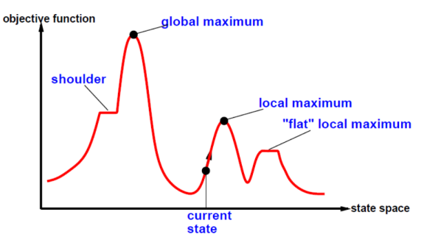
Contd..

Slide 13
Different regions in the state space
Local Maximum
Local maximum is a state which is better than its neighbor states, but there is also another state which is higher than it.
Global Maximum
Global maximum is the best possible state of state space landscape. It has the highest value of objective function.
Current state
It is a state in a landscape diagram where an agent is currently present.
Plateau
A flat area of the state-space landscape. It can be:
Flat local maximum
All the neighbor states of current states have the same value and no uphill exit exists
Shoulder
A flat area from which has an uphill edge and progress is possible

Slide 14
Algorithm
Step 1: Evaluate the initial state, if it is goal state then return success and Stop.
Step 2: Loop Until a solution is found or there is no new operator left to apply.
Step 3: Select and apply an operator to the current state.
Step 4: Check new state:
If it is goal state, then return success and quit.
Else if it is better than the current state then assign new state as a current state.
Else if not better than the current state, then return to step2.
Step 5: Exit.

Slide 15
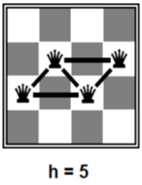
Hill Climbing Example: n-queens
Put n queens on an n × n board with no two queens on the same row, column, or diagonal
Here, goal is initially unknown but is specified by constraints that it must satisfy

Slide 16
Contd..
Move a queen to reduce number of conflicts.
Objective function: number of conflicts (no conflicts is global minimum)
The successors (successor function) of a state are all possible states generated by moving a single queen to another square in the same column
The heuristic cost function h is the number of pairs of queens that are attacking each other, either directly or indirectly.
The global minimum of this function is zero, which occurs only at perfect solutions.

Slide 17
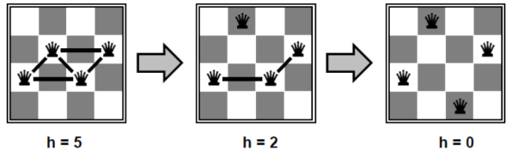
Contd..
Almost always solves n-queens problems almost instantaneously for very large n, e.g., n = 1 million.

Slide 18
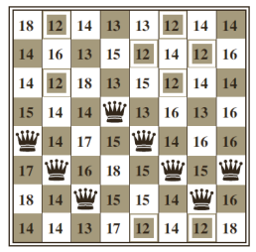
Task
Put n queens on an n × n board with no two queens on the same row, column, or diagonal

Slide 19
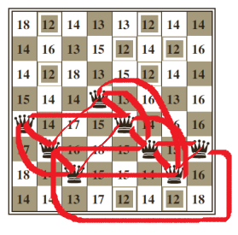
Example 2: Contd..
An 8-queens state with heuristic cost estimate h=17
The value of h for each possible successor obtained by moving a queen within its column.

Slide 20
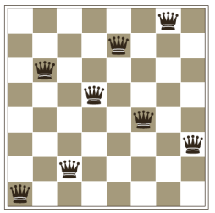
Solution
A local minimum in the 8-queens state space; the state has h=1.

Slide 21
Problems in Hill Climbing Algorithm
Although greedy algorithms often perform well, hill climbing gets stuck when:
Local maxima/minima
Plateau (shoulder or flat local maxima/minima)
Ridges

Slide 22
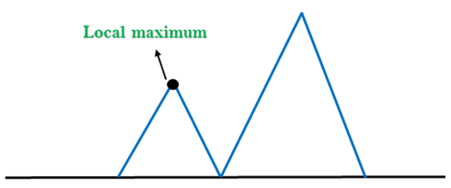
1. Local Maximum
A local maximum is a peak state in the landscape which is better than each of its neighboring states, but there is another state also present which is higher than the local maximum.
Solution: Backtracking technique can be a solution of the local maximum in state space landscape. Create a list of the promising path so that the algorithm can backtrack the search space and explore other paths as well.

Slide 23
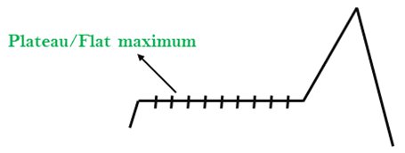
2. Plateau
A plateau is the flat area of the search space in which all the neighbor states of the current state contains the same value, because of this algorithm does not find any best direction to move. A hill-climbing search might be lost in the plateau area.
Solution: The solution for the plateau is to take big steps or very little steps while searching, to solve the problem. Randomly select a state which is far away from the current state so it is possible that the algorithm could find non-plateau region.

Slide 24
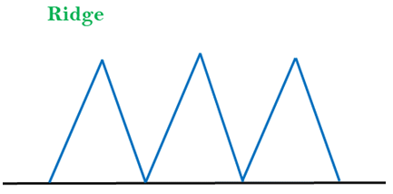
3. Ridges
A special form of the local maximum. It has an area which is higher than its surrounding areas, but itself has a slope, and cannot be reached in a single move
Solution: With the use of bidirectional search, or by moving in different directions, we can improve this problem.

Slide 25
Variants of Hill Climbing Algorithm
Stochastic hill Climbing
First-Choice Hill Climbing
Random-Restart Hill Climbing

Slide 26
END

